Slide 1



Mantle LITHOLOGIES of the Zuni Bandera Volcanic Field: Determined by Minor Element Ratios of Olivine
Carmen Winn
Mentor: Mary Reid
Northern Arizona University
NASA Space Grant Symposium

Slide 2
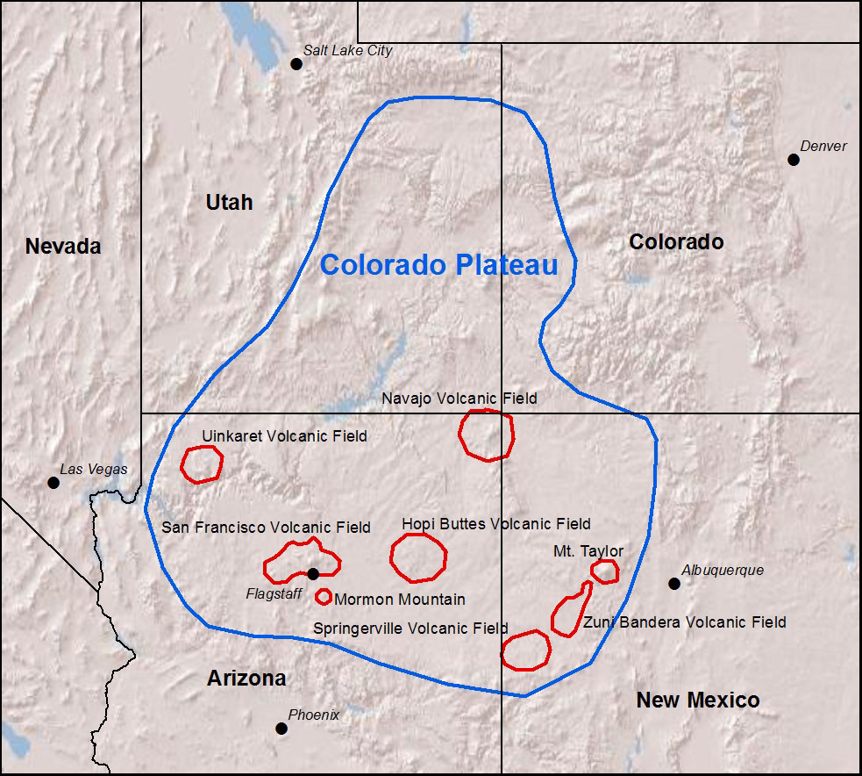
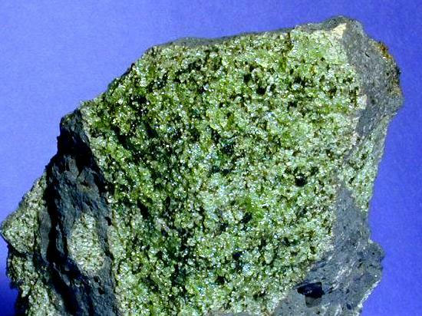
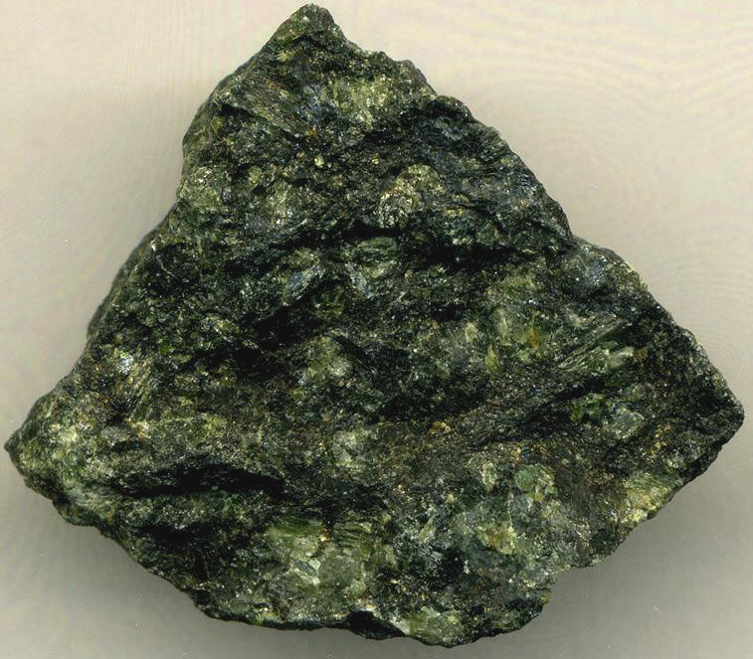
What’s melting under the Colorado Plateau?
Young, mafic volcanism on the margins of Colorado Plateau: no clear mechanism of origin
Evidence for heterogeneous source: what are the roles of multiple rock types melting?
Peridotite
Image from
www1.newark.
ohio-state.edu/
and/or
Pyroxenite?
Image from
www.utexas.edu/
tmm/npl/mineralogy

Slide 3
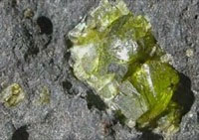
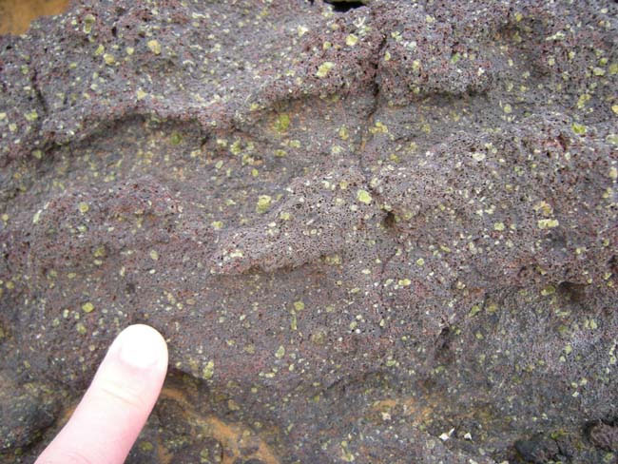
TRANSITION METAL RATIOS (Zn/Fe):
A WINDOW INTO MELT SOURCE COMPOSITION
Melting a rock: different elements/minerals behave differently as melting progresses
  When source controlled by olivine Zn/Fe shouldn’t change much
Transition metals not very affected by degree of melt
Olivine crystals can preserve element equilibrium in earliest stages of crystallization (closest to melting conditions)
Image from
serc.carleton.edu/
Fe Zn Cr Co
Mg Mn Ni V
Image from www.nvcc.edu/

Slide 4
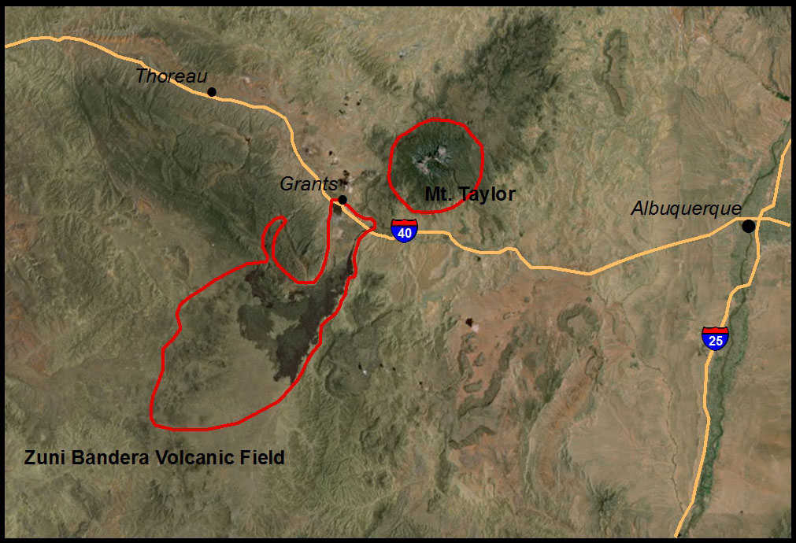
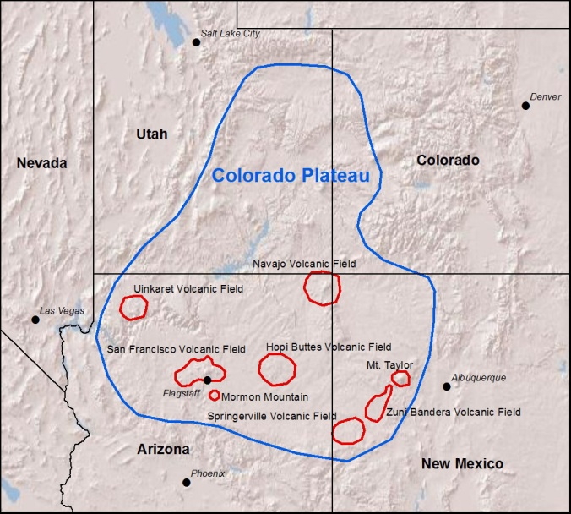
VISITING A SOURCE: ZUNI BANDERA VOLCANIC FIELD

Slide 5
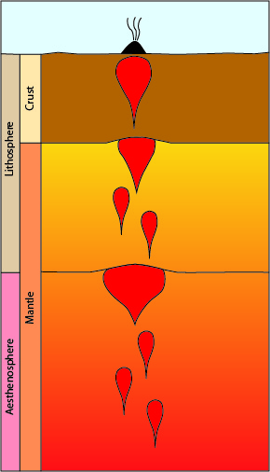
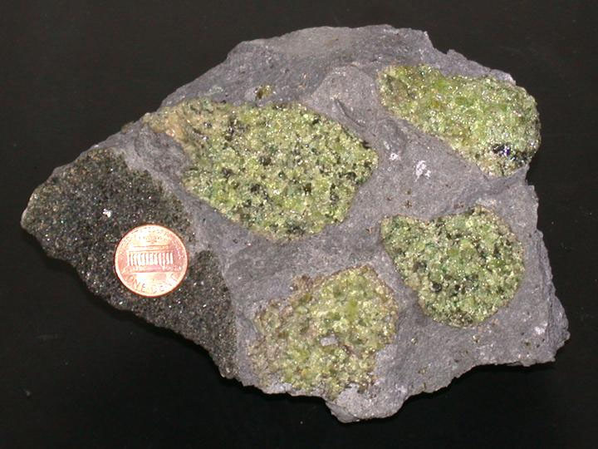
Why Zuni Bandera Volcanic Field?
Zuni Bandera Volcanic Field: young, mafic field on eastern Colorado Plateau margin
Mantle (melt source) samples found nearby at Mt. Taylor: testing the Zn/Fe ratio
Rocks from wide range of melting depths present
Image from umanitoba.ca/geoscience/

Slide 6
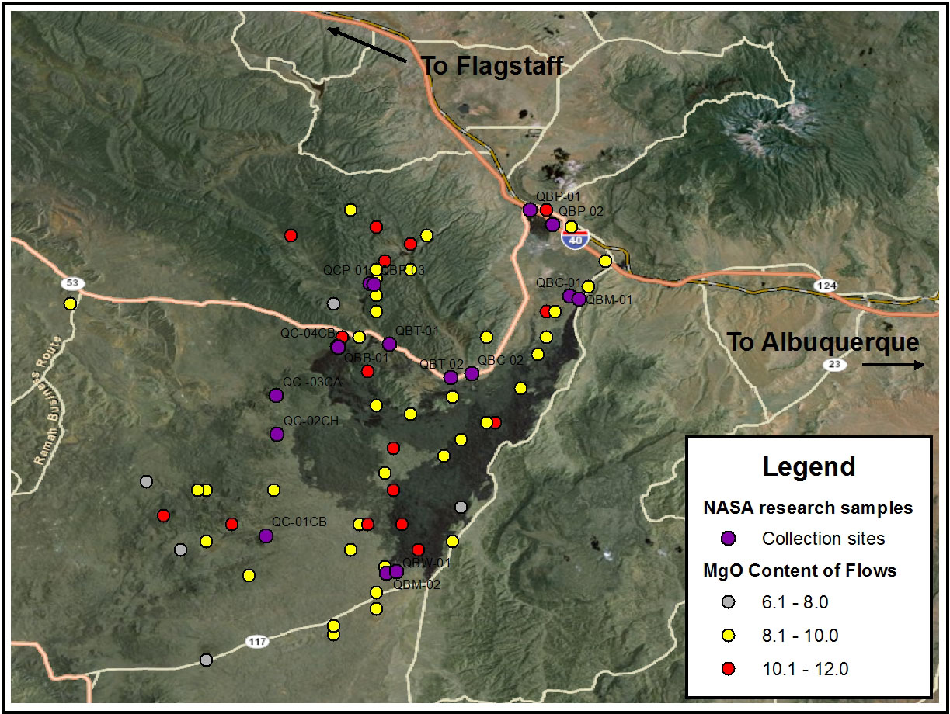
COLLECTING THE DATA: FIELDWORK
Flows with high Mg content (closest to melting conditions) targeted for sampling
Map produced and analyzed in ArcGIS using
previously published data to target collection sites

Slide 7
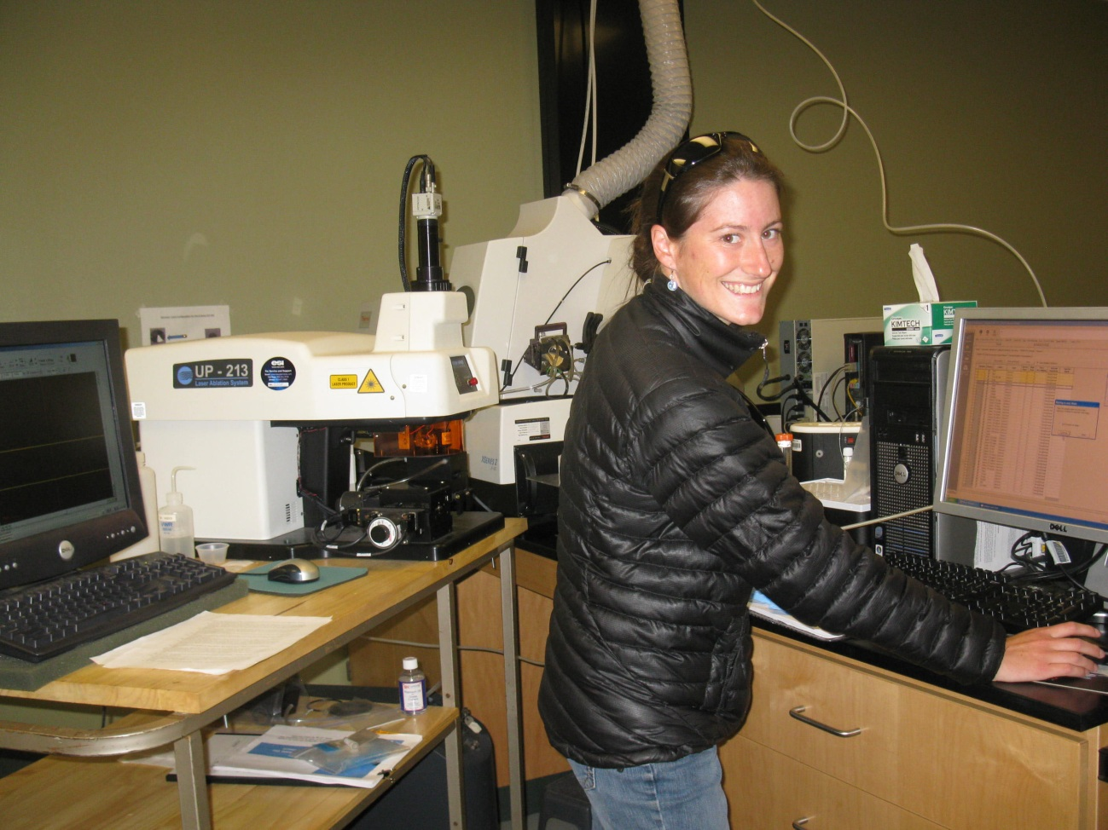
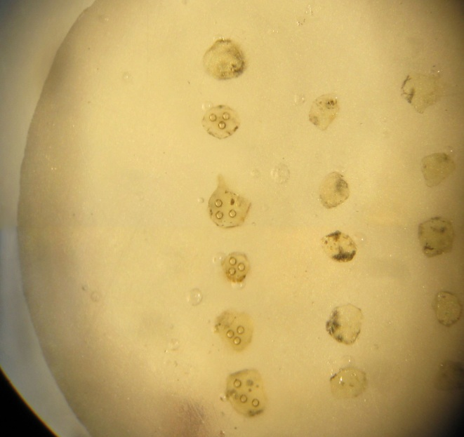
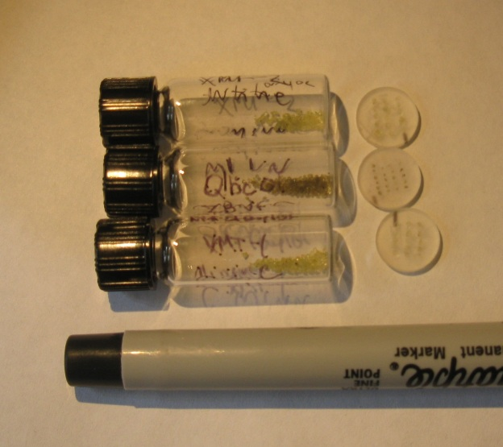
COLLECTING THE DATA: Labwork
Grains of olivine separated and mounted
Composition determined with Laser Ablation ICPMS
Data from ICPMS calibrated to known basalt and mantle standards
ICPMS
Laser Ablation
Notes:
Image – me w/ ICPMS at NAU (camera…) and grain mount

Slide 8
Zn/Fe RATIOS COMPARED TO MELT EVOLUTION
Increased differential melting

Slide 9
MELTING CONDITIONS OF ZUNI BANDERA BASALTS

Slide 10
DISCUSSION AND CONCLUSIONS
Zn/Fe ratio changes little with increasing degree of melting
  Good ‘window’ for olivine-rich vs olivine-poor lithologies
Zn/Fe ratios show more fertile source than standard CO Plateau and mid-ocean ridge (Iceland) mantle
  Not high enough for pyroxenite, but fertile peridotite possible
  Possible ‘plums’ of fertile mantle beneath the CO Plateau volcanic fields to induce melting
Wide range of depth and temperature of melting with normal trends
In the future:
  A more detailed analysis of the geochemistry of Zuni Bandera: other minor element ratios and trace elements
  What do other volcanic fields show about CO Plateau mantle?

Slide 11
ACKNOWLEDGEMENTS
A big thank you to:
Mary Reid, Research Mentor
Kathleen Stigmon and Nadine Barlow
Sean Rudzitis and Corinne LaViolette
Arizona NASA Space Grant
Northern Arizona University

Slide 12
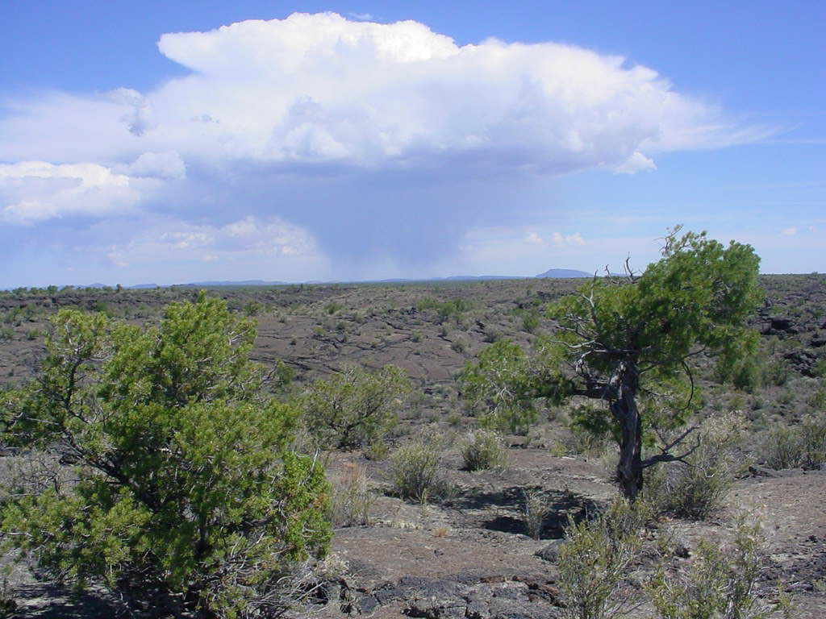
QUESTIONS?
Image from www.nps.gov/elma, 2012

